Slide 1
System Setup
Install Oracle XE
SQL Developer Installation
Workstation Setup
Download Database Scripts
Setup Sample Data Models

Slide 2

Installing Oracle XE
Download OracleXE112_Win32.zip
System Requirements
Requirement | Explanation
OS | Microsoft Windows 2000 SP4 or greater
Disk Space | 1.75 GB of free space
Memory | 512 MB or RAM
Network | The TCP/IP network protocol must be configured and working
Internet Access | While not mandatory, it is recommended that you have internet access

Slide 3

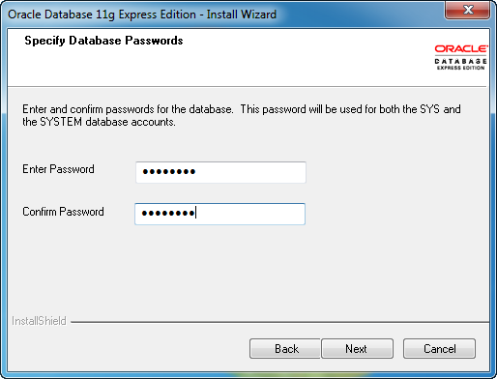
Installing Oracle XE
Pay close attention to this step.

Slide 4
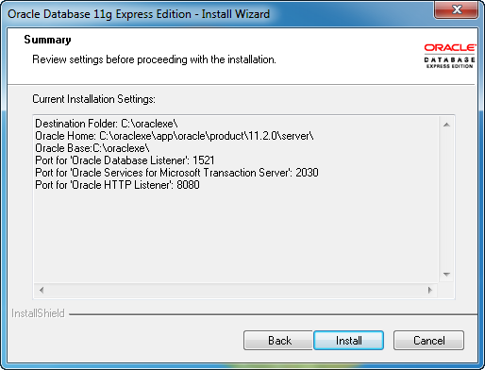
Installing Oracle XE
Pay close attention to the final step.

Slide 5
SQL Developer Installation
Installing SQL Developer is extremely simple.
It only requires that you copy the files to a folder on your system.
Once the copied, find the sqldeveloper.exe file.

Slide 6

Final System Course Setup
Download Database Scripts
Create and Fill Database Tables

Slide 7
Using the Database Interface
Selecting the Appropriate Tool
Database Connections
Bind Variables
Using SQL Plus
Using SQL Developer

Slide 8





Selecting the Appropriate Tool
Oracle SQL Developer – Used by database developers [replaces SQL Plus]
Oracle Enterprise Manager SQL Worksheet – Used by database administrators, application server administrators, and web server administrators
Oracle SQL Plus – Occasionally used by database administrators
Oracle Application Express – Used by database developers for web-based applications
Oracle JDeveloper Studio – Used by Java database developers

Slide 9

Authentication Elements
User Authentication – User credentials are authenticated to ensure access is authorized.
Database Authentication Elements
Element | Description
User name | This is the name of the database account. It is created by the database administrator.
Password | This is the security password associated to the database account.
Role | Some Oracle tools require a connection role or privilege desired for the connection. DBA’s sometimes connect using SYSOPER, SYSDBA, or SYSASM.

Slide 10

Oracle Database Connections
Users are authenticated against a database instance. The instance identification is based upon a database connection definition.
This detail is often stored in the TNSnames.ora file.
Element | Description
Host name | This is the host name or the IP address of the database server.
Port | This is the port number of the database listener API running on the host system.
SID | This identifies the System Identifier, which is the unique name for the database server.

Slide 11
Bind Variables
Bind Variables are a method to make PL/SQL and SQL code dynamic.
DECLARE
x_salary employee.salary%TYPE;
BEGIN
SELECT salary
INTO x_salary
FROM employee
WHERE ssn = :ssnValue;
END;
/

Slide 12
Oracle Tools
Oracle SQL Developer - Most of our work will be performed using this tool.
Oracle SQL*Plus – This is a command line tool to interface with your database.

Slide 13
Language Features
Understanding PL/SQL
Network Performance Gains
Database Efficiency Gains
Structure of a PL/SQL Program Block
Language Syntax Rules
Using PL/SQL from SQL Plus

Slide 14
The DECLARE Clause
About the DECLARE Clause
Available Data Types
DECLARE Simple Types
DECLARE Complex Types
%Type
%RowType Record
Type…Table
Type…Record
Extended User-Defined Types

Slide 15
The BEGIN Clause
About the BEGIN Clause
Performing Data Manipulation
PL/SQL and SQL Features
SQL DML within PL/SQL
Logic Control & Branching
Program Labels & GOTO
Loop
If-Then-Else
Case

Slide 16
The EXCEPTION Clause
About the EXCEPTION Clause
Exception Processing
Isolating the Specific Exception
Pragma Exception_Init
Using the SQLCODE & SQLERRM Error Function
Implicit Cursors
User-Defined Events

Slide 17
EXPLICIT Cursors
About EXPLICIT Cursors
Extended Cursor Techniques
Updateable Cursors
Including Cursor Parameters
Using FOR…LOOP Cursors

Slide 18
Advanced Programming – Nested Blocks
Using Nested Blocks
Why Use Nested Blocks
Global vs. Local Objects
Global vs. Local Exceptions

Slide 19
Advanced Programming – Declared Subprograms
Using Declared Subprograms
Procedure Example
Function Example

Slide 20

Oracle 11g PL/SQL Fundamentals I
Timothy J. Miles

